Slide 1

Introduction to Machine Learning
by: Eng. Alaa Al Nissany

Slide 2
Some informations about the team
PhD. Yazan Dayoub An AI researcher, PhD Student in the field of Deep learning and Computer Vision, and a Kaggle Expert.
Eng. Saba Salah An Artificial intelligence team leader at Inshar, with a Master Degree in Artificial Intelligence and Robotics from Islamic Azad University.
Eng. Mehya Mahfoud A Mid/Senior full stack web Developer with High Knowledge in the field of Deep learning and Machine Learning.
Eng. Alaa Al Nissany A Mid-Level Machine learning Engineer, and Data Scientist with a piece of high knowledge in the field of Computer Vision, and a Kaggle Expert.

Slide 3
Machine Learning
Artificial intelligence
Reinforcement Learning
Deep Reinforcement Learning
Deep Learning

Slide 4
What is Machine learning?
Machine Learning is the field of study that gives computers the ability to learn without being explicitly programmed. —Arthur Samuel, 1959
A computer program is said to learn from experience E with respect to some task T and some performance measure P, if its performance on T, as measured by P, improves with experience E. —Tom Mitchell, 1997

Slide 5
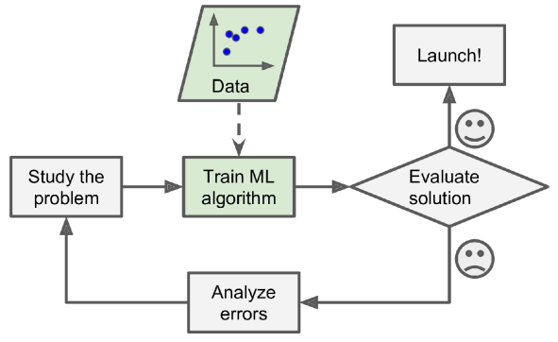
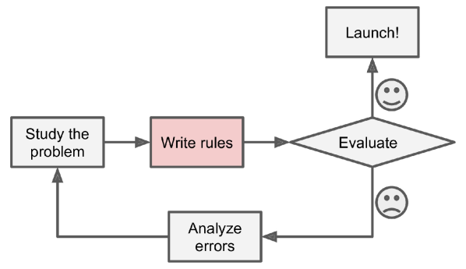

Slide 6
Machine Learning
Supervised Learning
Unsupervised Learning
Reinforcement Learning
Classification
Clustering
Q-Learning
Regression
Anomaly Detection
DQN
Ranking
Dimensionality reduction

Slide 7
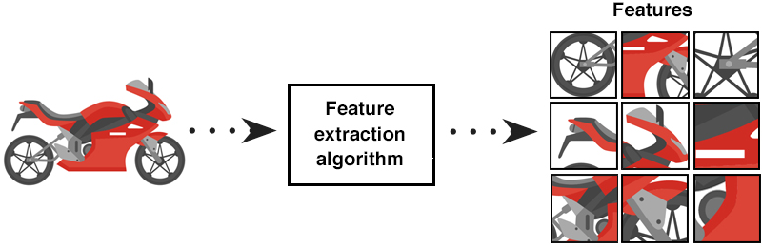
Features

Slide 8
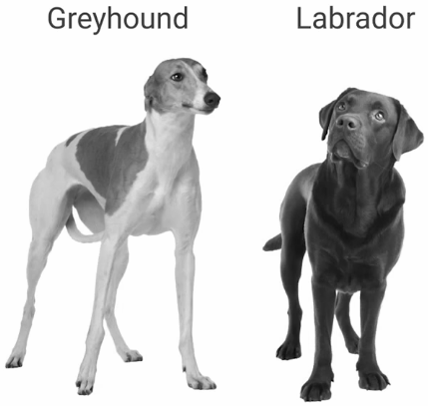
Find the features that differentiate between Greyhound and Labrador?

Slide 9
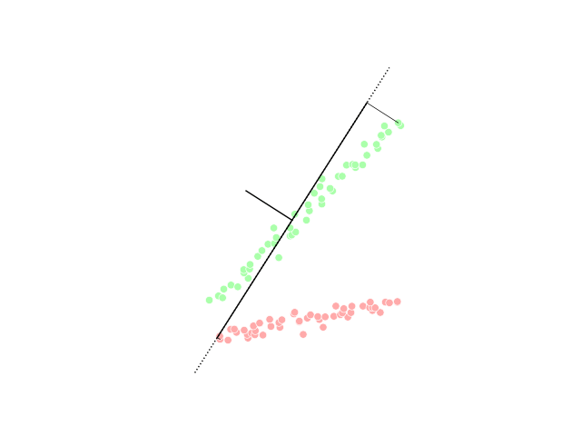
Poor feature vs Strong one
Distinctive
Representative
Relevance

Slide 10
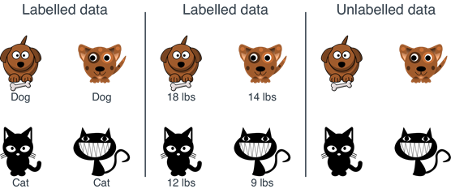
Labeled vs unlabeled data

Slide 11
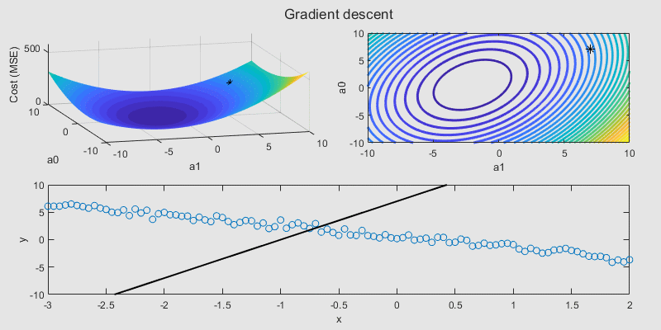
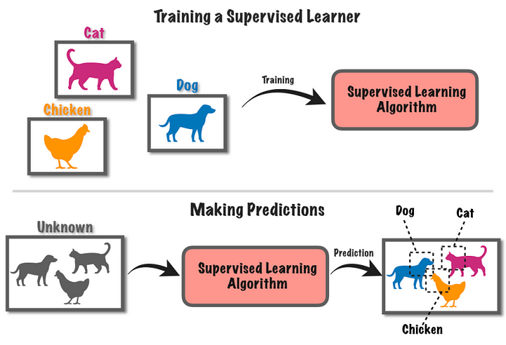
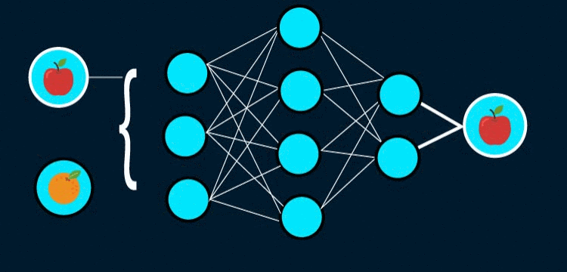
Supervised Learning

Slide 12
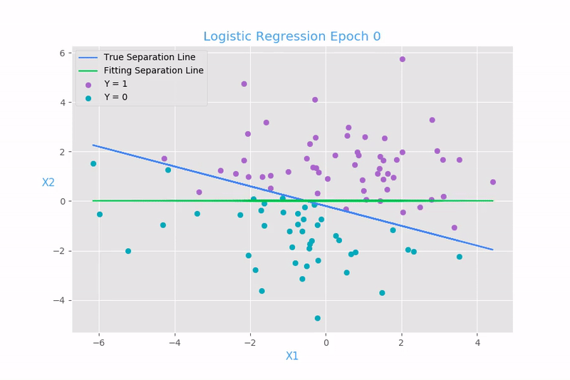
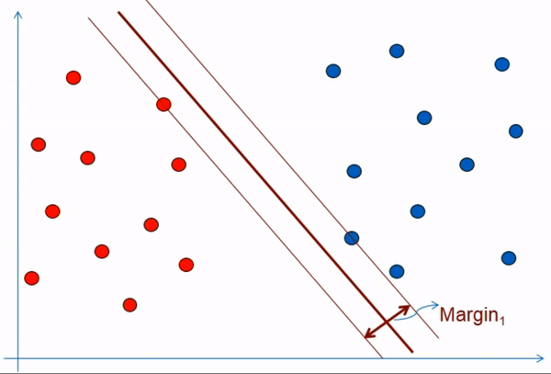
Classification

Slide 13
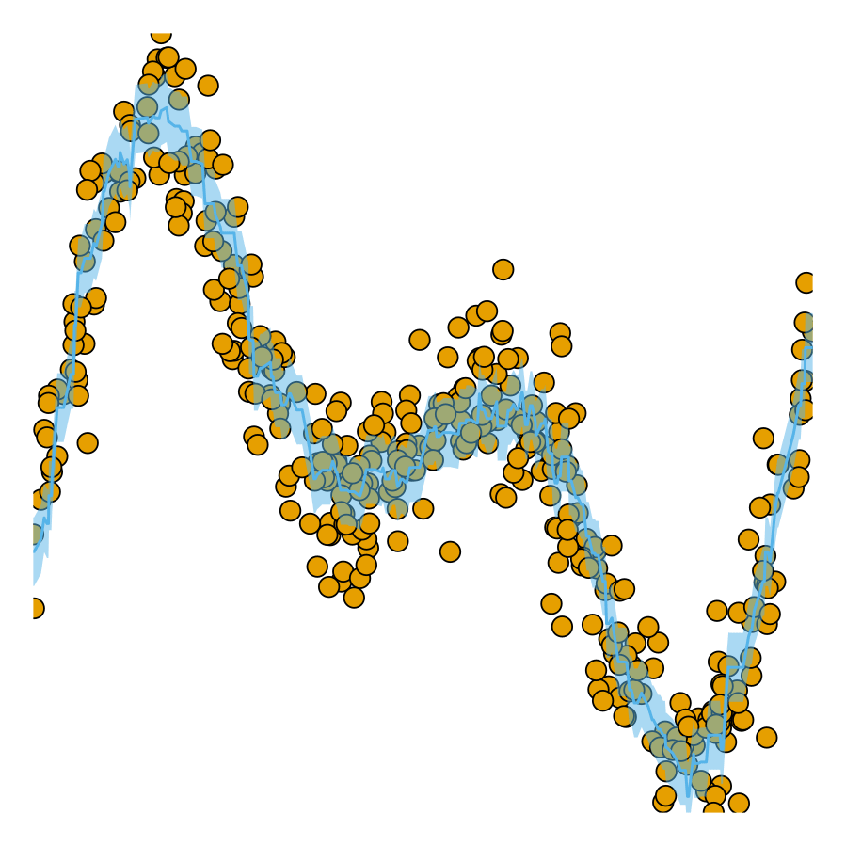
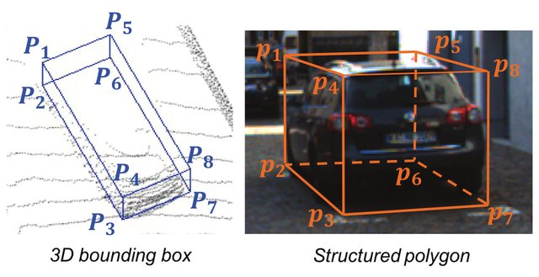
Regression

Slide 14
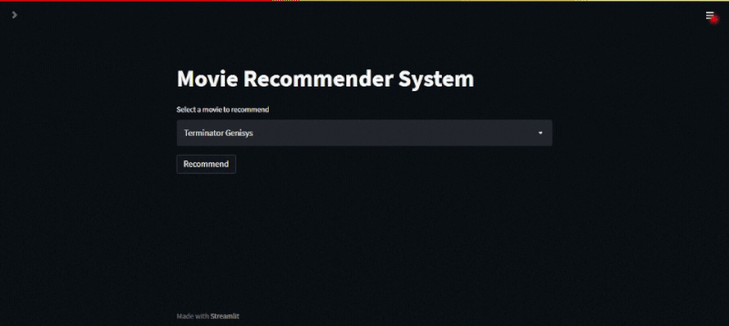
Ranking

Slide 15
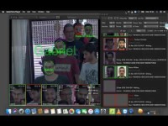

Slide 16
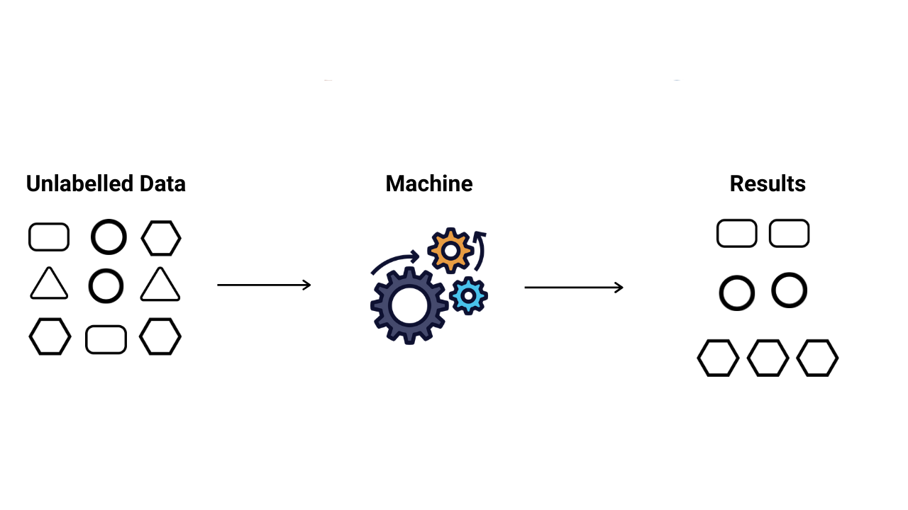
Unsupervised Learning

Slide 17
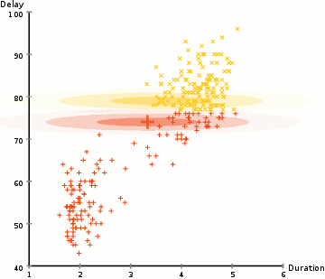
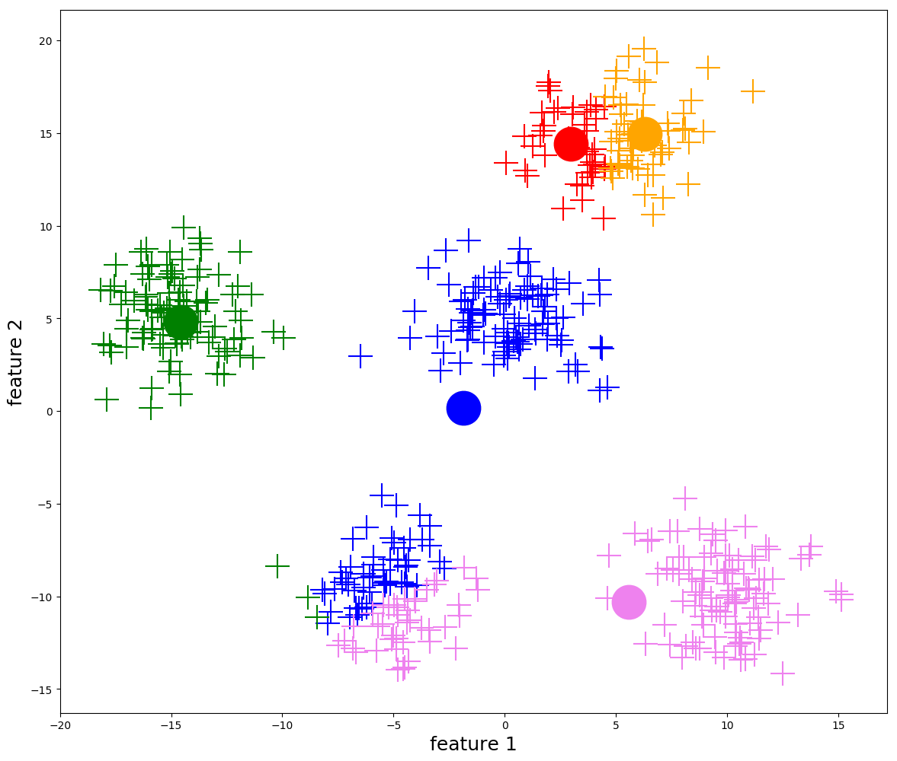
Clustering

Slide 18
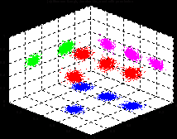
Dimensionality reduction

Slide 19
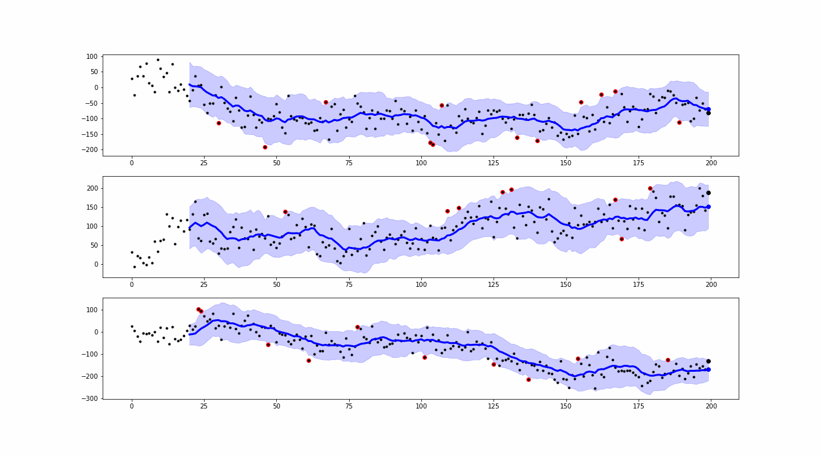
Anomaly Detection

Slide 20
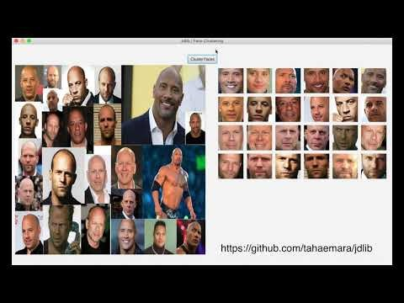

Slide 21
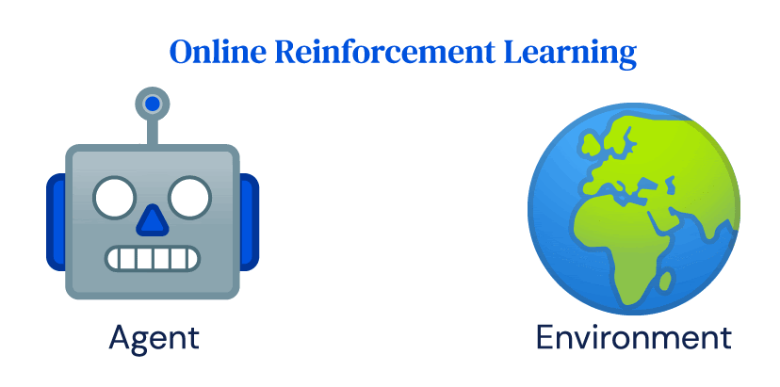
Reinforcement learning

Slide 22
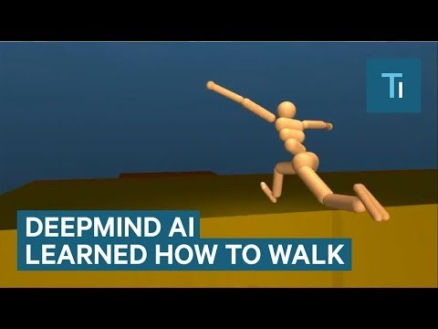

Slide 23
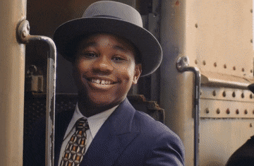
Thank you for listening

Slide 24
Any Questions
?

